Slide 1

TailwindCSS
Under the hood

Slide 2
Outline
Introduction
How TailwindCSS built?
Its pros and cons
Best practices

Slide 3
1. Introduction
A utility-first CSS framework for
rapidly building custom designs

Slide 4
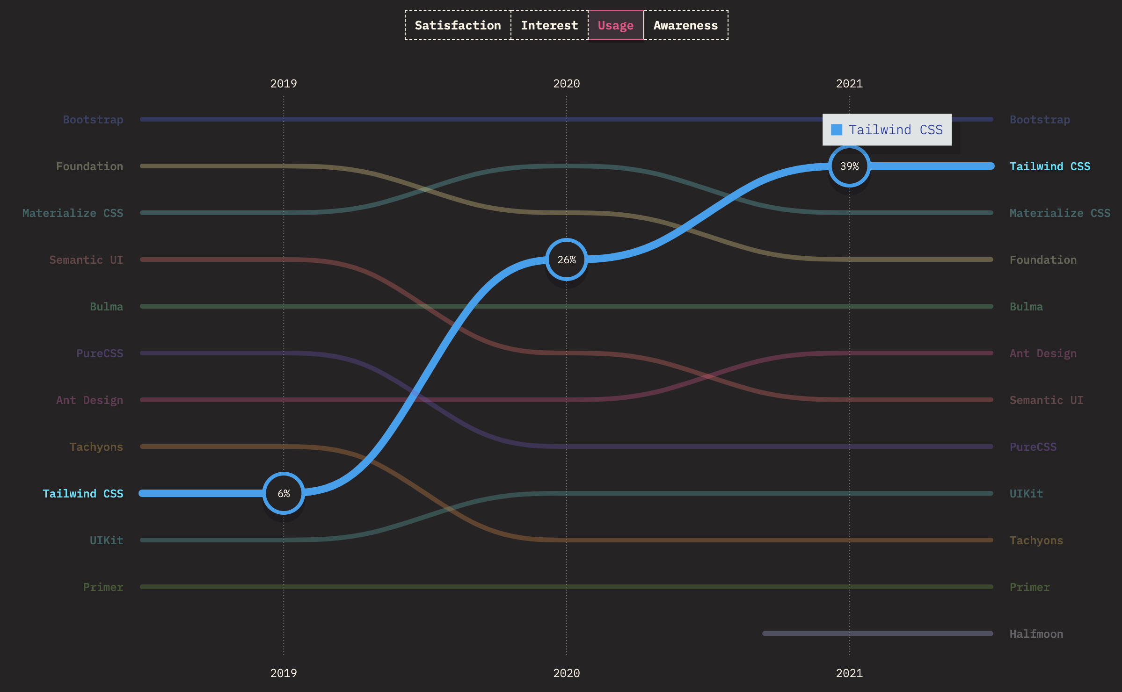
1. Introduction
Satisfaction, interest, usage, and awareness

Slide 5
2. How TailwindCSS built?
Based on PostCSS and its plugins (postcss-import, postcss-js, …)
NodeJS for everything (build, cli, …)

Slide 6
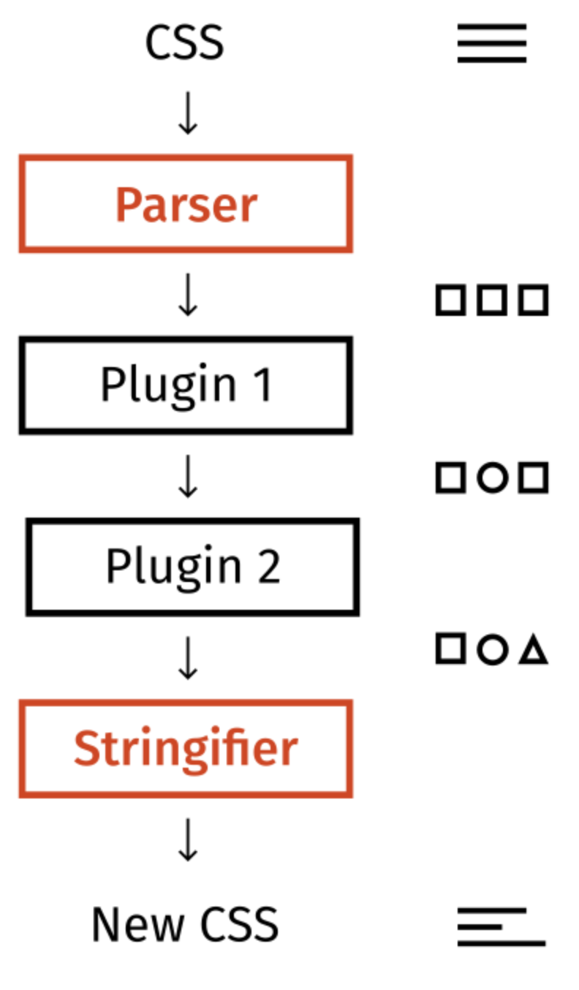
2. How TailwindCSS built?
Basically, it’s just a PostCSS plugin. Same as well-known ones such as Autoprefixer, Stylelint, CSSnano
A high-level overview of the whole PostCSS workflow

Slide 7
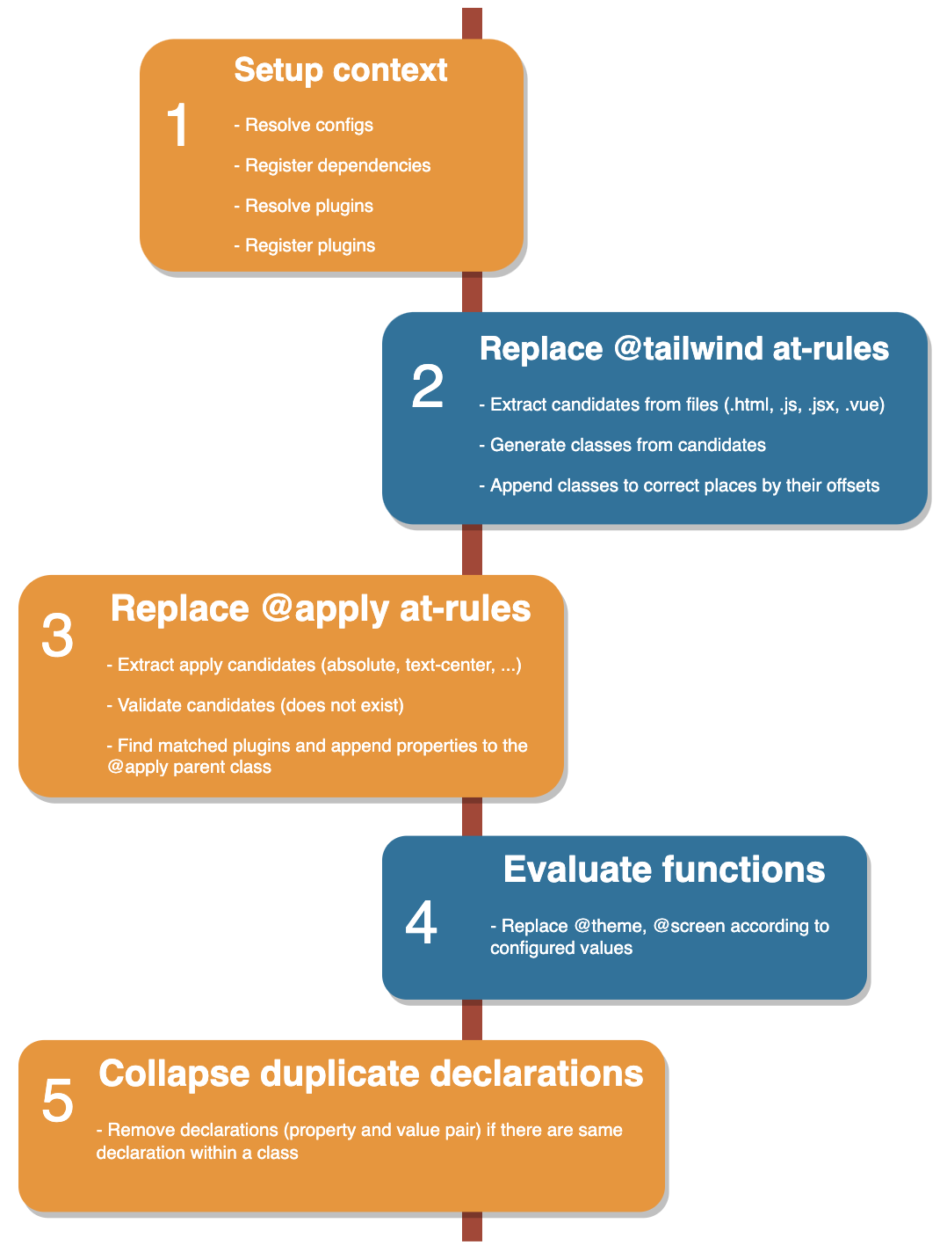
2. How TailwindCSS built?

Slide 8
3. Its pros and cons
Props:
Faster development
Shipping less CSS code (< 10kb)
Highly reusable
Highly customizable
Built-in responsive & variants
Cons:
Repeating classes
Hard to read
Learning curve (low-level framework)

Slide 9
4. Best practices
- Don’t use @apply just to make things look cleaner
- Extracting repeating classes into components
- Using an object variable (clsx, classnames for conditionally joining )
- Do utilities in an order with meaning (1. positioning/visibility 2. box model 3. borders 4. backgrounds)

Slide 10
Q&A

Slide 11
Thank you

